Slide 1

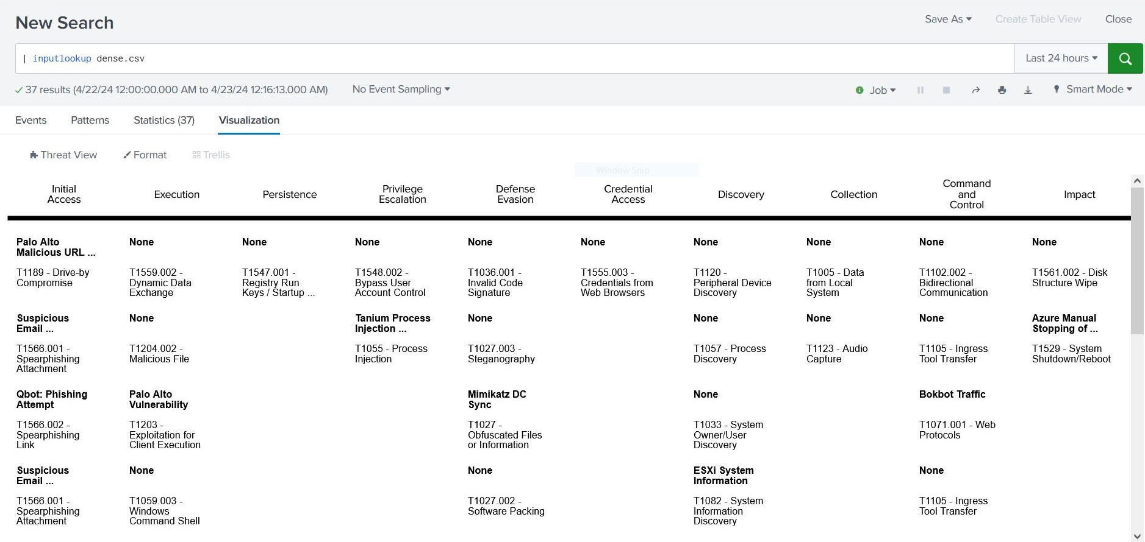
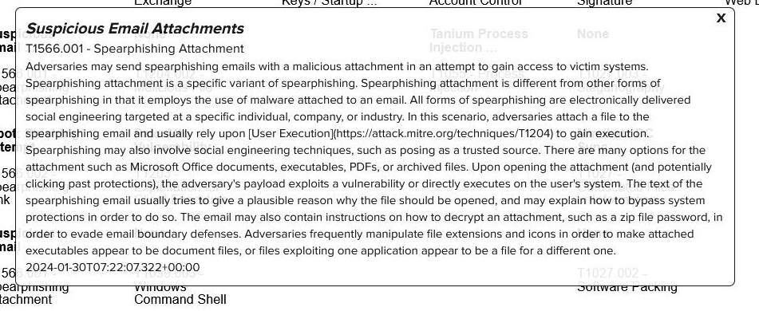
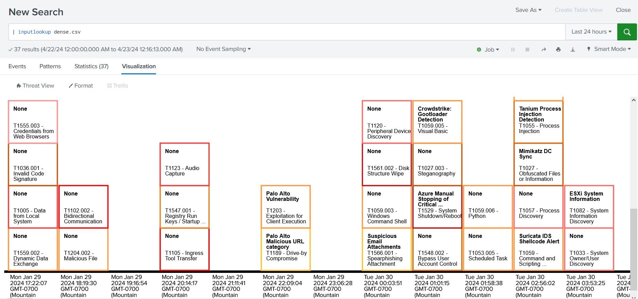
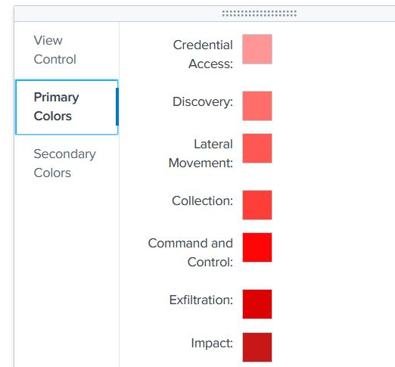
Say "Hello" to Threat View!
A new tool for cyber defense!
By: Danae O'Connor & Noah Warren Sponsor: Vuong Tran – Cybersecurity Analyst
The Problem:
Needing to analyze cyberthreats within Splunk Enterprise.
Our Solution:
Building a Splunk Enterprise visualization tool that organizes cyberthreats by severity or time with expandable details for each cyberthreat and color-changing ability for severity identification.
Tactic Visualization:
Card Preview:
Timeline Visualization:
Color Selector:

Slide 2
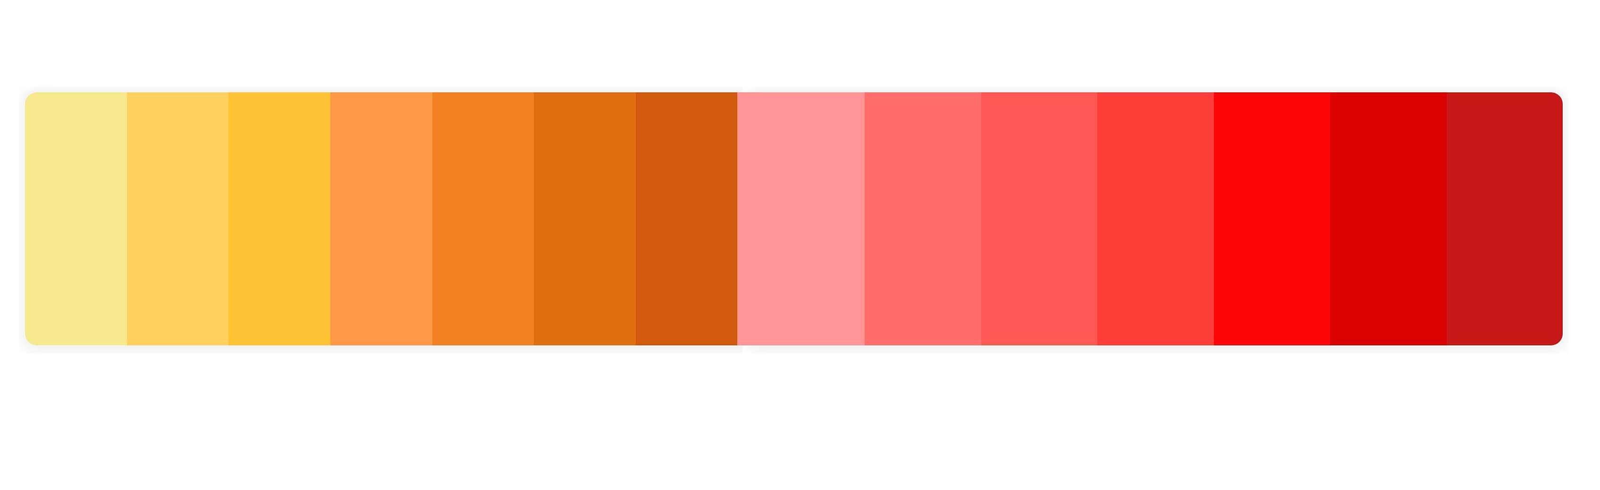
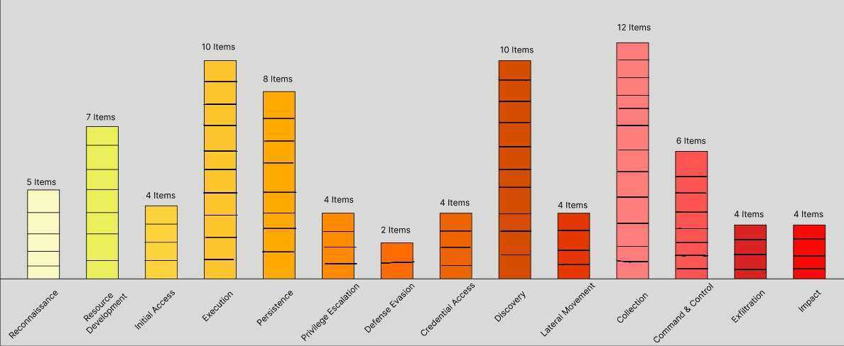
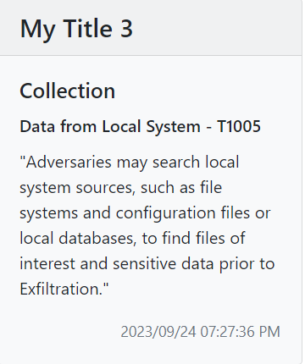
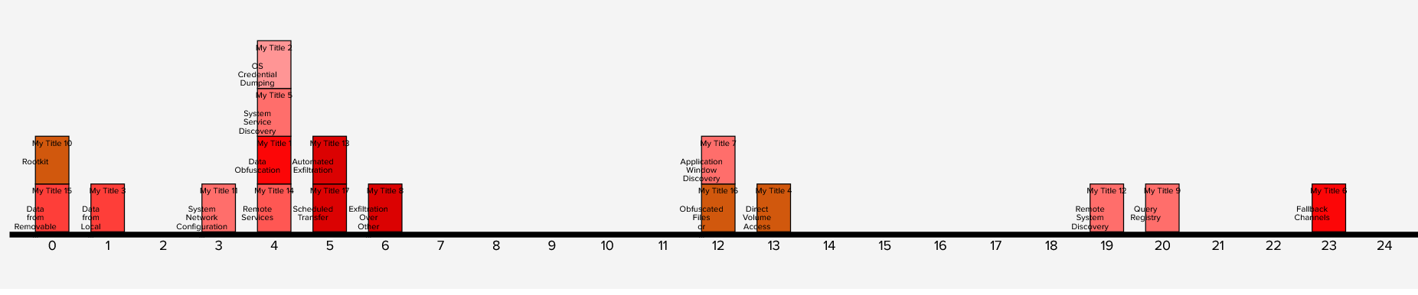
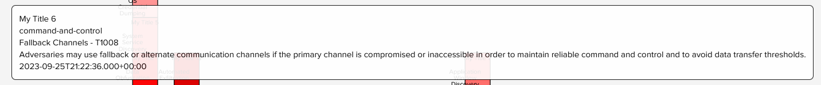
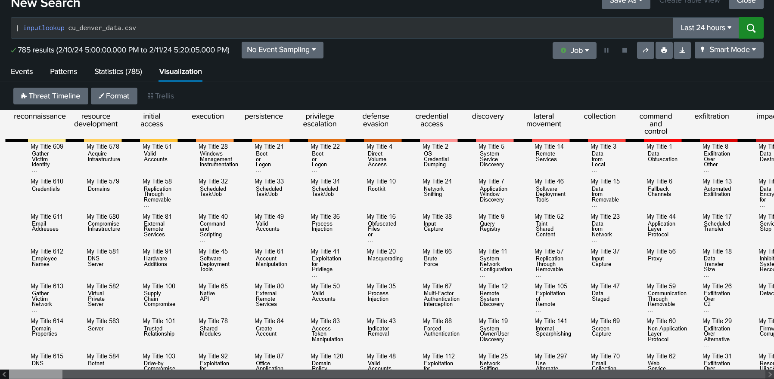
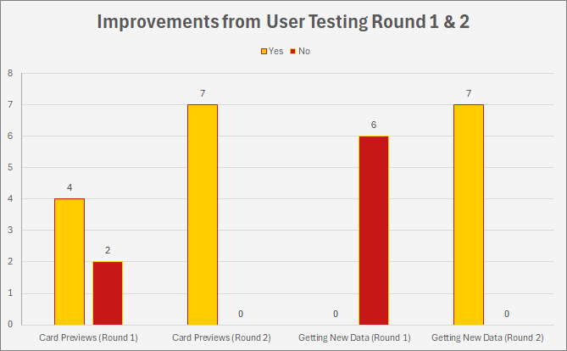
Design & Methodology
Identified the required features:
Multiple views by organization of threats
Cards for cyberthreats
Expandable information on threats
Created initial prototypes based on card decks & bar-chart designs
Iterative creation & testing of features
Challenges Faced During Development
Lack of informative documentation
Difficulties with debugging
Graphic implementations
Data input issues
Testing Results:
Problem-Features:
Getting updated data
Card previews unclear
After Adjustments:
Users retrieving updated data increased by 100%
Success with opening card previews increased by 49.25%

